Slide 1
Introduction
Digital Business Technology

Slide 2
Table of content
Socio-technology
Diffusion of technology
Technology-Economy
Job prospect
Emerging Technologies

Slide 3
Socio-Technical System
Technical System
Social System
Social System
Technical System
Socio-Technical System

Slide 4
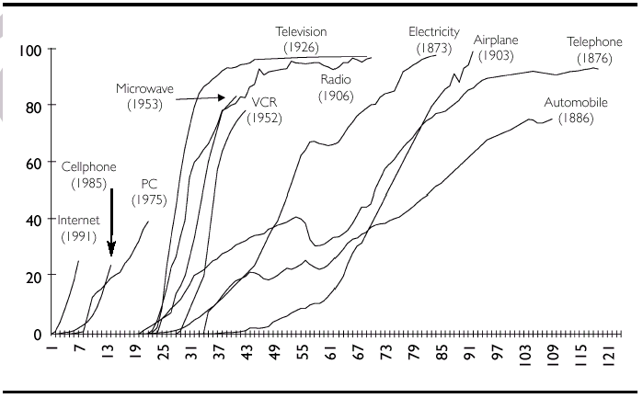
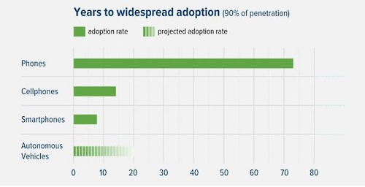
Diffusion of technology
Time to take until 50M users (year)
38
16
13
4
<1
Radio
PC
TV
Internet
Smartphone

Slide 5
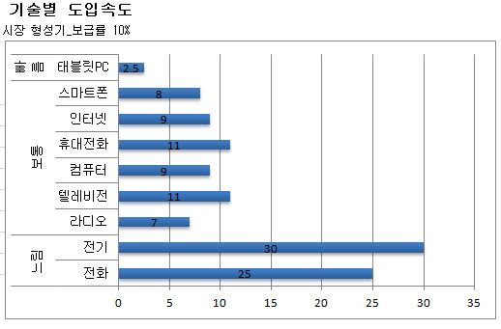
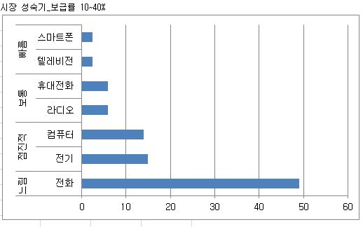
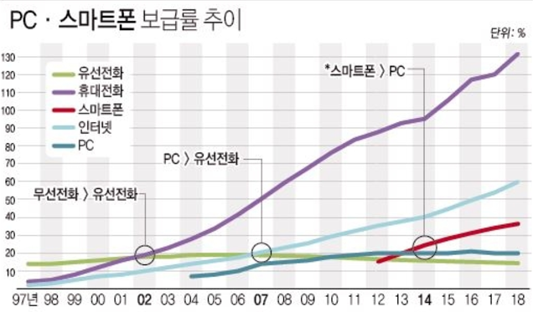
기술의 확산
연합뉴스
연합뉴스

Slide 6
Future of Work Report – MS 2022
The Hybrid Work Era has begun
New technologies are rapidly improving work
Hybrid meeting technologies, Workplace recommendation systems, VR/AR
Improved practices can make work better now
The definition of productivity is expanding
There is much to learn about The Hybrid Work Era
Notes:
https://www.microsoft.com/en-us/research/uploads/prod/2022/04/Microsoft-New-Future-Of-Work-Report-2022.pdf

Slide 7
Future of Work Report
OECD 2019
Risk of job automation is real but varies greatly across countries
14% of jobs are at high risk of automation
32% of jobs could be radically transformed
Social protection needs to be adapted to the future of work
Self-employment, part-time and temporary work are on the rise in some countries.
6 out of 10 adults lack basic ICT skills or have no computer experience.
Notes:
https://www.oecd.org/future-of-work/Future-of-work-infographic-web-full-size.pdf

Slide 8
Impact of automation
SOURCE: World Bank; Oxford Economics; McKinsey Global Institute analysis
Notes:
FTE: Full-time Equivalents

Slide 9
Lessons from History
AUTOMATION = HOPE + CHALLENGE
Technology displaces some works, but creates new jobs in unforeseen ways
Individuals must prepare for lifelong learning and evolving careers
Acquire new skills that are in demand
Consider new ways of working

Slide 10

A General summary of the development model
The social assimilation of technological revolutions
breaks each great surge of development in half
approaching maturity
restricting the growth
(of productivity, markets and profits
→ social and political unrest conditions
→ migration of markets
→ production activities to the peripheries
→ search for new technologies
economic and
social polarization

Slide 11
The role of the major technology bubbles
Parallel surges with major bubbles, Golden Ages and approximate dates of Turning Points
Golden Age
Gilded Age
Golden Age

Slide 12
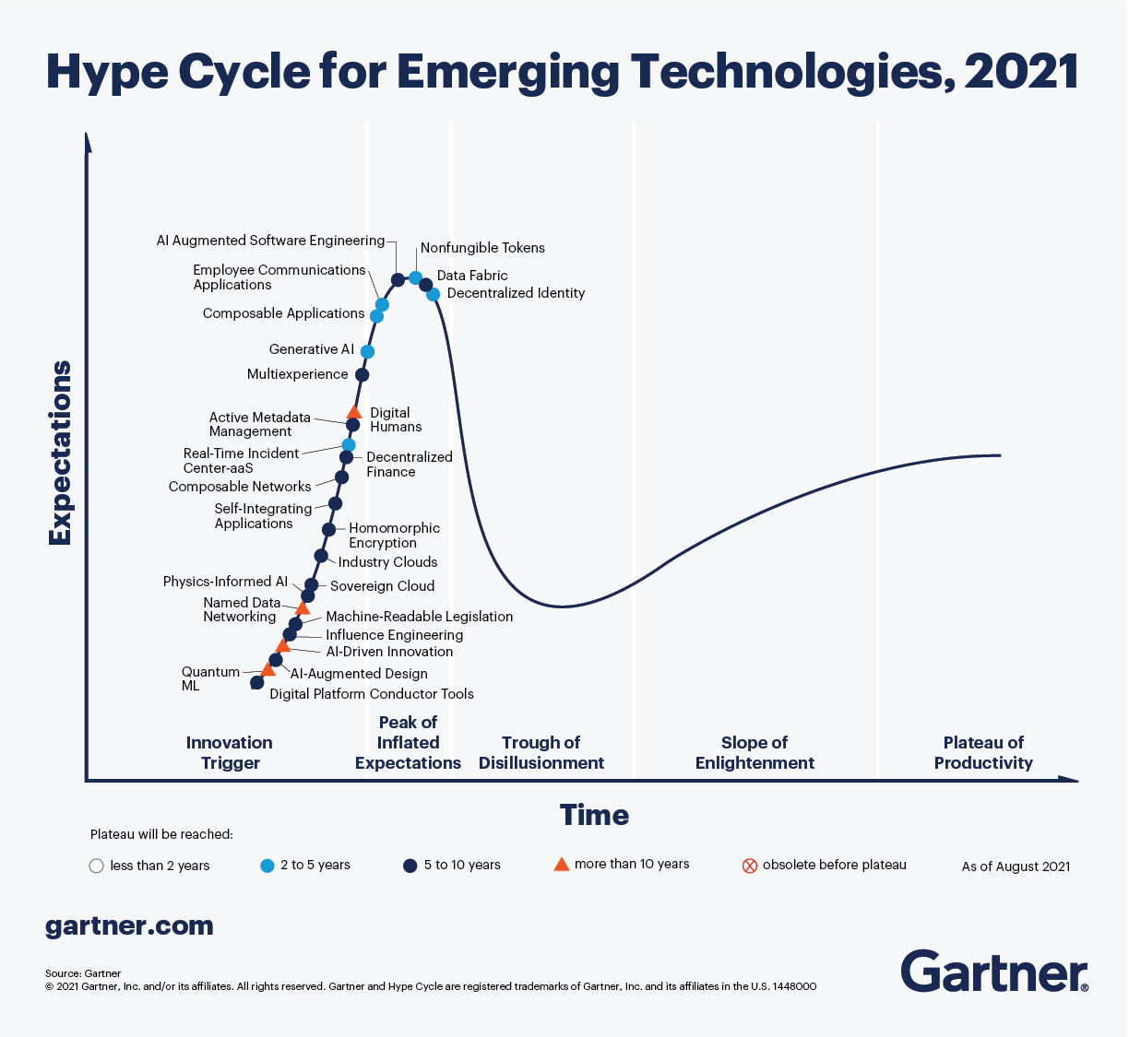
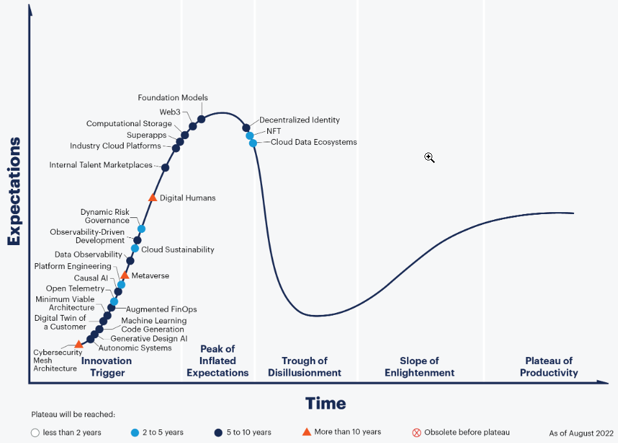
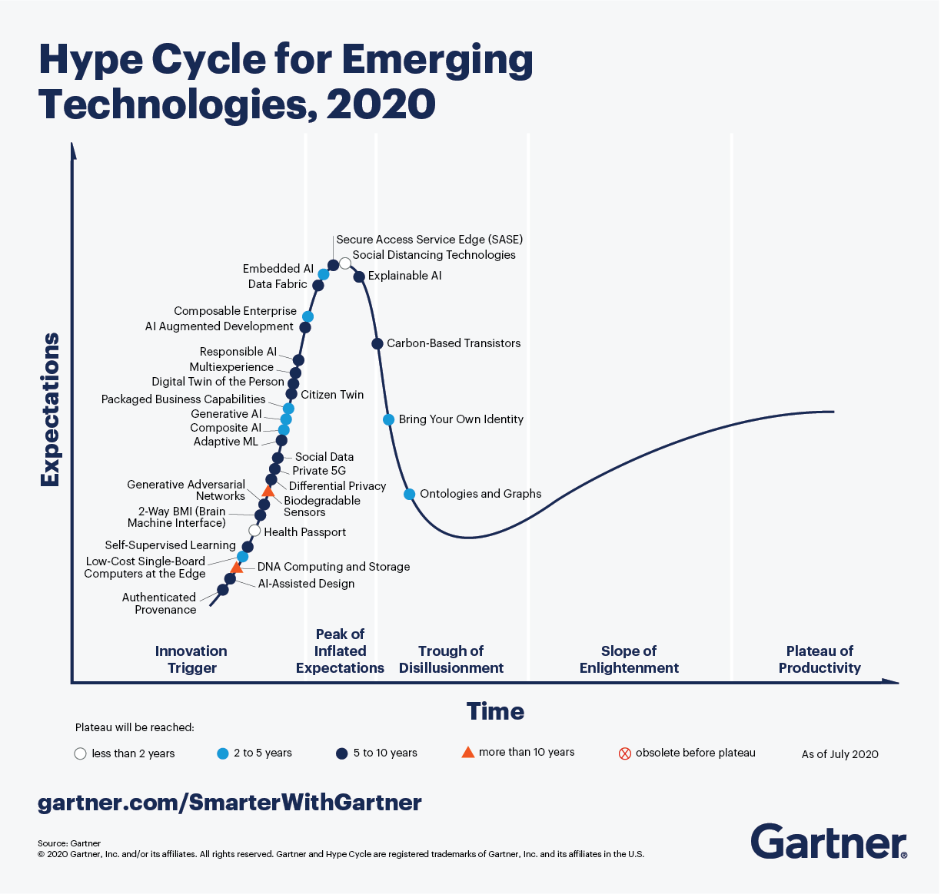
Gartner's Hype Cycle for Emerging Tech, 2022

Slide 13
3 Themes in the Hype Cycle
Evolving/expanding immersive experiences
Digital twin of the customer, Decentralized identity, Digital humans
Internal talent marketplaces, Metaverse, Non-fungible token(NFT)
Superapp, Web3
Accelerated AI automation
Autonomic systems, Causal AI, Foundation models
Generative design AI, Machine learning code generation
Optimized technologist delivery
Cloud data ecosystems, Augmented FinOps, Cloud sustainability
Computational storage, Cybersecurity mesh architecture
Data observability, Dynamic risk governance, Industry cloud platforms
Minimum viable architecture, Observability-driven development
Open Telemetry, Platform engineering

Slide 14
Hype Cycle

Slide 15
Hype Cycle
기대
활용되는 기술
사장되는 기술
부활하는 기술
시간
출현
과장
실망
수용
보급
자료원: Gartner Group
Notes:
출현(Innovation Trigger) 단계: 상품의 시제품을 알리거나 어떠한 이벤트를 벌여 기술의 가능성을 알리는 단계로 기술의 성숙도는 낮음
기대 과장(Inflated Expectations) 단계: 언론에 큰 반향을 일으켜 갑자기 기술에 대한 평판이 과장되는 단계
실망(Trough of Disillusionment) 단계: 언론에서 떠들었던 것이 사실 과장이었다는 것을 인식하는 단계
점진 수용(Slope of Enlightenment) 단계: 언론에 노출되는 정도는 극히 적어지나 기술을 수용해 효용성과 실제적인 적용에 대해서 이해하는 단계
안정화(Plateau of Productivity)/보급 단계: 기술이 널리 알려지고 받아들여지며 점점 안정화 되어가고, 2세대 혹은 3세대로 진화하는 단계

Slide 16
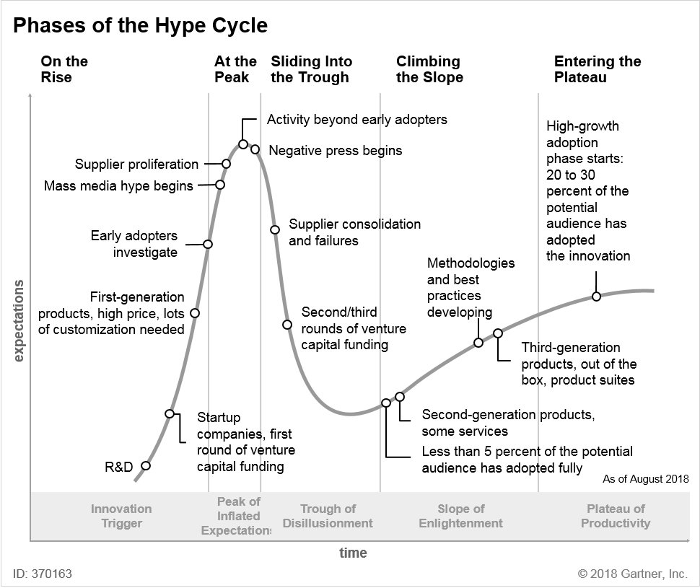
Phases of the Hype Cycle
Source: Gartner (August 2018)

Slide 17
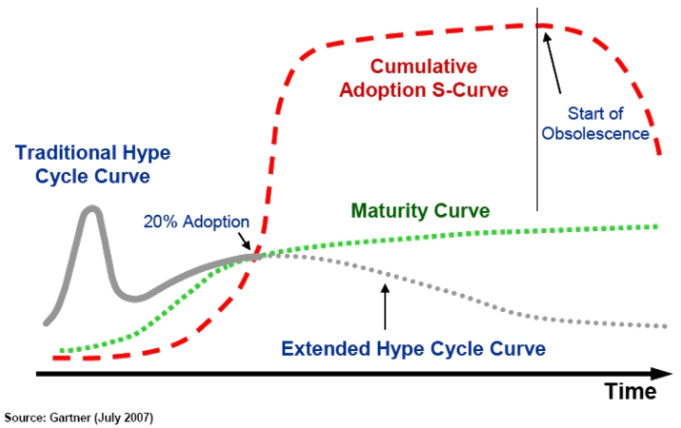
Adoption curve

Slide 18
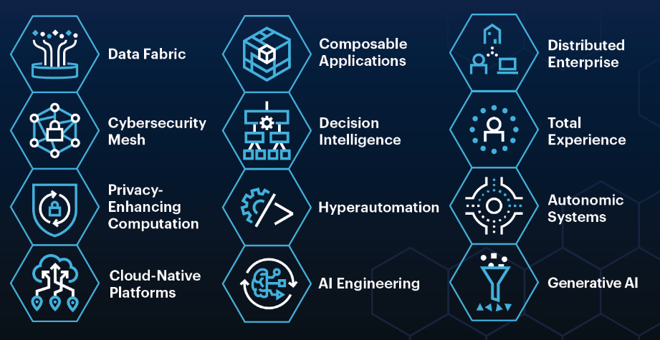
Top Strategic Technology Trends for 2022
Engineering Trust
Sculpting Change
Accelerating Growth
Gartner

